Slide 1
Tic-Tac-Toe Primer 4 n00bs
By Dabeer Mirza ft. Redbull

Slide 2
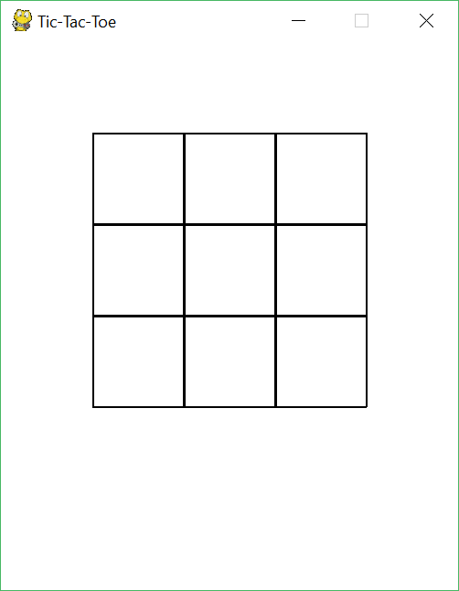
Let’s first consider just the board
Consider making a grid. What shapes should we use? There are 2 ways to go about this:
Make 1 large rectangle and add 4 lines
Make 9 rectangles (how I personally went about it)
So how to we go about making this grid every frame (Hint: Use more than 1 loop)
We’ll also need to store the “state” of each box (i.e. if it’s got an X or O inside of it). How do we go about this? (Big hint: Think of a matrix!)

Slide 3
Now let’s focus on each box…
As touched on before, each box can have 3 different states. Namely:
Blank (neither player has clicked on the box)
X (player 1 has clicked on the box)
O (player 2 has clicked on the box)
How would you go about drawing these (consult the Python Primer!)
Blank box
X in the box
O in the box

Slide 4
Check for input
You’ll need to implement a method s.t. when you click on the screen, it should be able to detect if you’ve clicked on a box.
Hint: If you know the top-left corner of the grid and the length of the box (their identical), then finding if the coordinates are within a box should be simple enough.
Let’s simplify this a little bit and consider the case where we just have a single square…
You will know: the box’s top-left corner, the length/width of the box and the x-y coordinates of the mouse click (consult the primer if you forgot how to check!).
∴ if (top-left corner x coordinate) ≤ mouse-click x coordinate ≤ (top-left corner x coordinate + box length), the mouse click is within the range of that particular box.
You obviously want to make sure that the box isn’t filled before adding an X or O! (Consider the matrix hint I gave earlier)
Let’s now expand this to 9 boxes… have fun!
Also consider a way to alternate between player 1 and player 2

Slide 5
Winning Condition
Brute force all the combinations
Hint 1 – Think about how to store the state of each cell (i.e. a matrix)
Hint 2 – Think of all the possible ways/combinations to win…

